Slide 1
West Bay Passive House
Presented By Teddy Dean and James Dean
To West Bay Public School Grade 6 Class

Slide 2
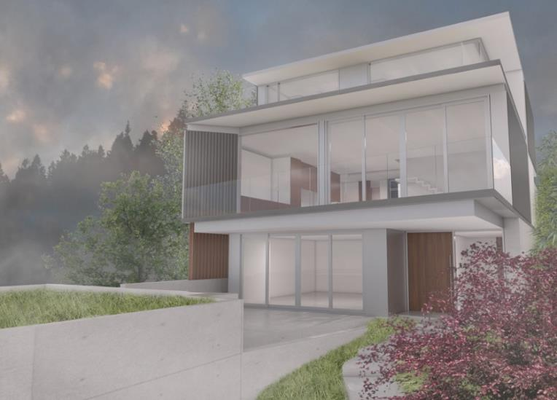


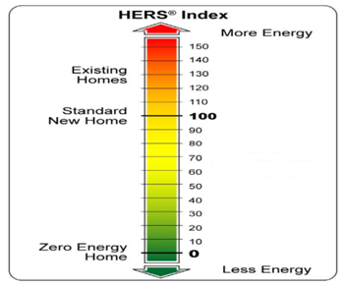
Our Passive House Goals: Comfortable, Healthy, Beautiful & Energy Efficiency
We are going to get our new house built and certified to 3 different labelling programs that all about using less energy. Our goal is to sell more energy back to BC Hydro over the year than we use.

Slide 3
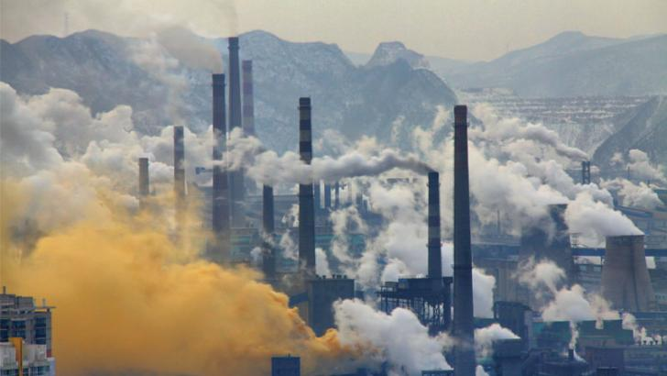
Since the Industrial revolution and the invention for the internal combustion engine we are burning more carbon based fuels like gasoline and coal which is increasing Carbon Dioxide levels and contributing to Climate Change

Slide 4
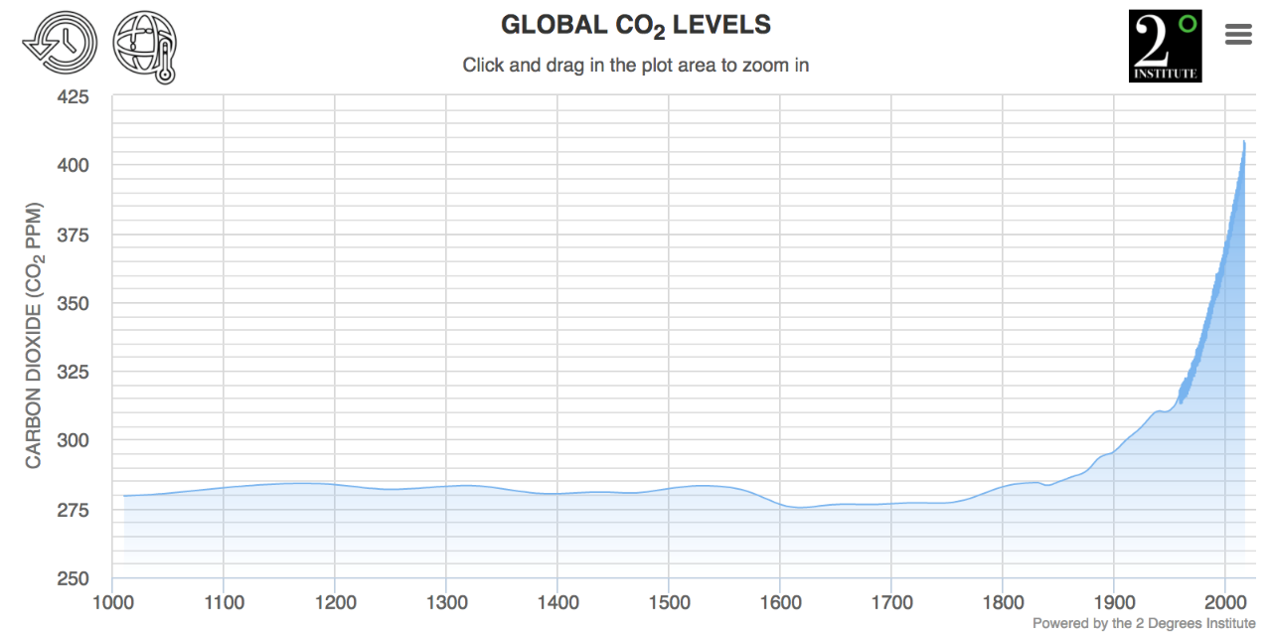
Automobile
Production
Begins
Industrial
Revolution
Begins
Oil Wells
Discovered
Here you can see a graph of the C02 levels increasing significantly since the 1800’s when these events began

Slide 5
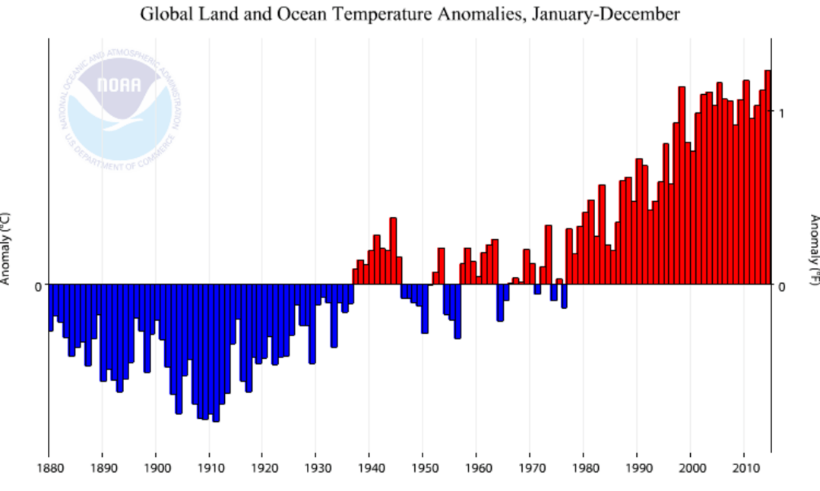
You can also see that since the early 1900’s temperatures have risen by about 2 degrees Celsius

Slide 6
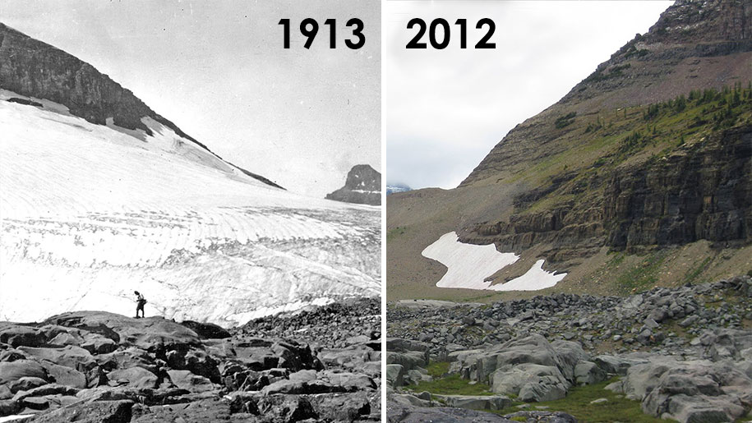
This rise in temperatures is having an effect on our planet with glaciers melting at a faster pace

Slide 7
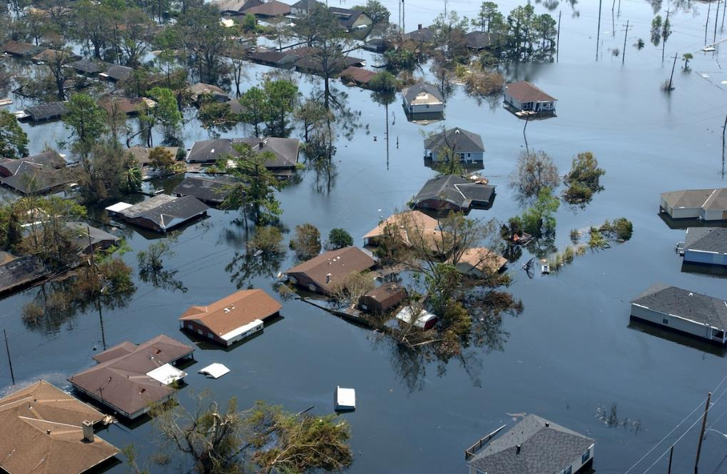
More storms and flooding is occurring from rising temperatures and more humidity in the air from the oceans warming

Slide 8
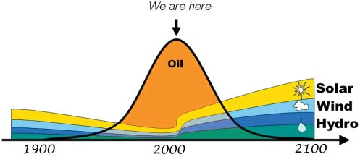
We are also running out of oil. Fortunately renewable power like Solar and wind are coming down in cost and being used more

Slide 9
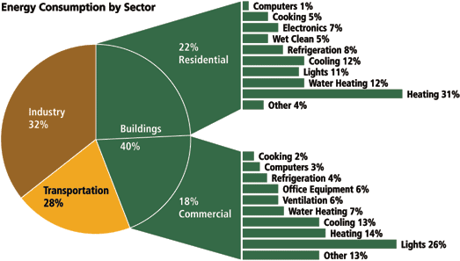
Buildings use 40% of the energy in North America and homes used 22% with heating & cooling the two biggest users of energy

Slide 10
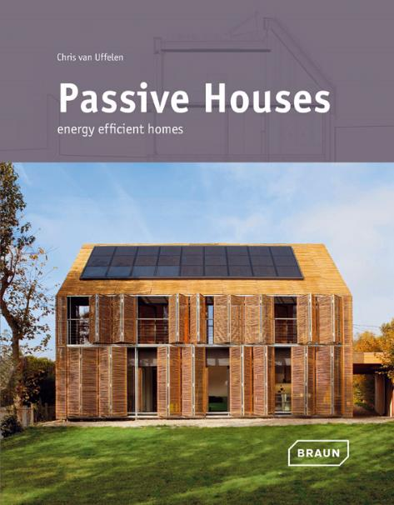
https://www.youtube.com/watch?v=CasrjYhZB1M
This is why we have decided to build a passive house. If we follow a few simple building principles we can reduce the amount of heating and cooling by 90% and the cost should be only 10% more. Here is a great video explaining Passive House.

Slide 11
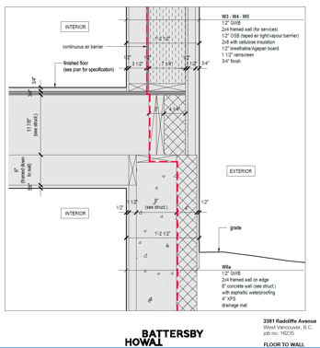
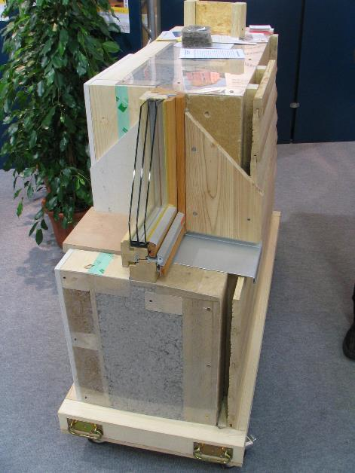
The first principle is to have well insulated walls with a lot of insulation. Our walls will be 15” thick with insulation on both the inside and outside of the wall

Slide 12
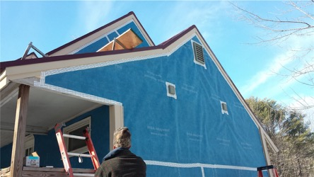
Prefab Super Airtight Wall Panels
Siga Membranes for airtightness and a dry envelope
We will use special membranes on the walls that will keep the cold air and water from coming in but allow any humidity to escape from the walls
Notes:
Entrepreneur from Vancouver Canada
I am actively involve in 2 associations for the ventilation industry
HVI- resi
Cerification program, 2nd driving growth of the industry through lobbying and education
Played in the 2005 world series of poker

Slide 13
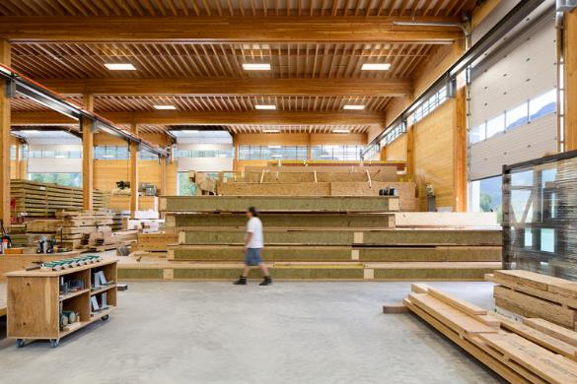
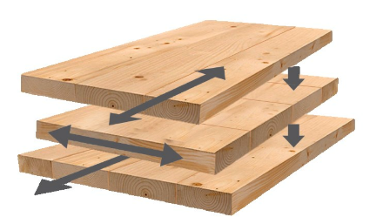
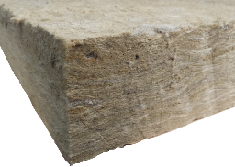
Building with Pre-fab Walls
Cross-laminated Timbers (CLT) with Roxul Mineral wool Insulation
Wood frame pre-fab with Cellulose Insulation
Our walls, floors and roof will be made inside a factory, delivered on a truck and assembled on site with a crane. This allows for quick and better quality construction. We looked at two different types of prefab walls and went with CLT’s and Roxul insulation

Slide 14
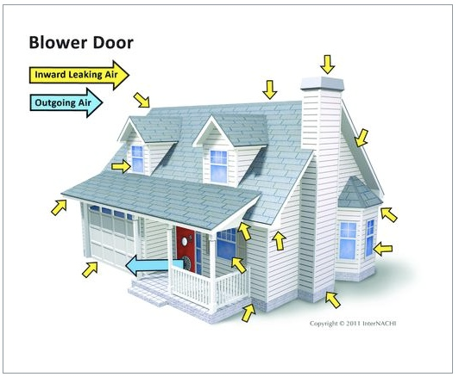
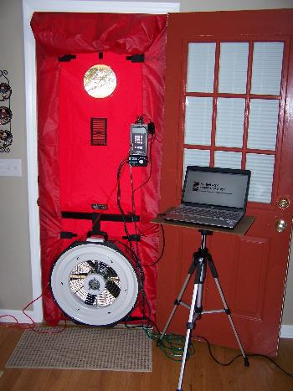
Blower Door Test with Leakage of <0.6 airchanges/hr
One of the tests we will do is called a blower door test to make sure there are no leaks in the walls, windows or doors. The tightest leak rates by building codes are a maximum of 3 air changes per hour and for Passive House we must be less than 0.6

Slide 15
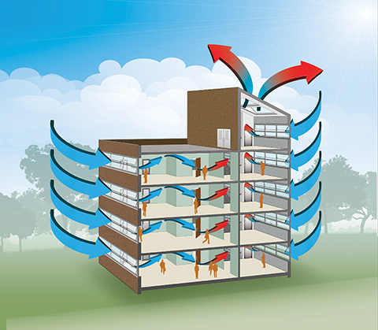
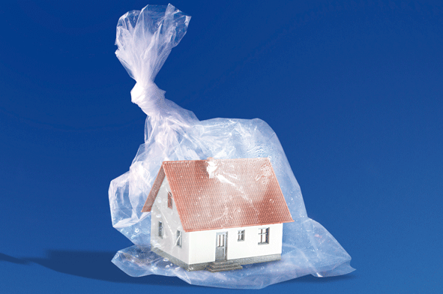
Ventilation with Fresh Air is Critical for Your Health
Because the house is built so air tight it would be like living in a plastic bag breathing all the harmful chemicals, odors, carbon dioxide and too high humidity. Passive House requires mechanical ventilation to bring fresh air in and exhaust the stale air.

Slide 16
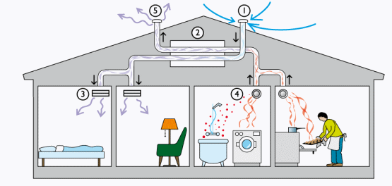
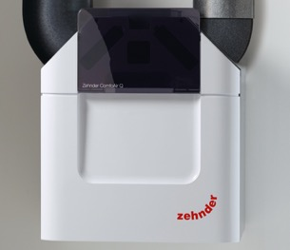
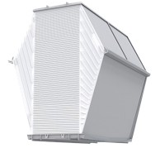
High Efficiency Energy Recovery Ventilation (ERV)
The mechanical ventilation is done with this product called an Energy Recovery Ventilator or ERV. Which brings fresh air into the living rooms and bedrooms and removes the stale air, odours and humidity from the bathrooms and kitchen. It uses a heat exchanger with a membrane to recover over 80% of the lost energy in heat and humidity. It is like having your windows open 24 hours a day all year long without losing the heat or cool air and not feeling uncomfortable from cold or hot air coming in
Notes:
One of the challenge of heat recovery system manufacturers is trying to differentiate their products to not be a commodity.
One of the key ways to differentiate on the components.

Slide 17
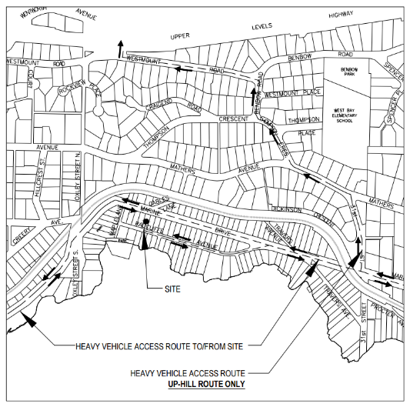
Try to position windows to take advantage of the sun for heating
West Bay
We are really lucky with our Passive House that it faces south towards the ocean and we can have a lot of windows for a great view but also use the sun to heat the house in the winter through the glass

Slide 18
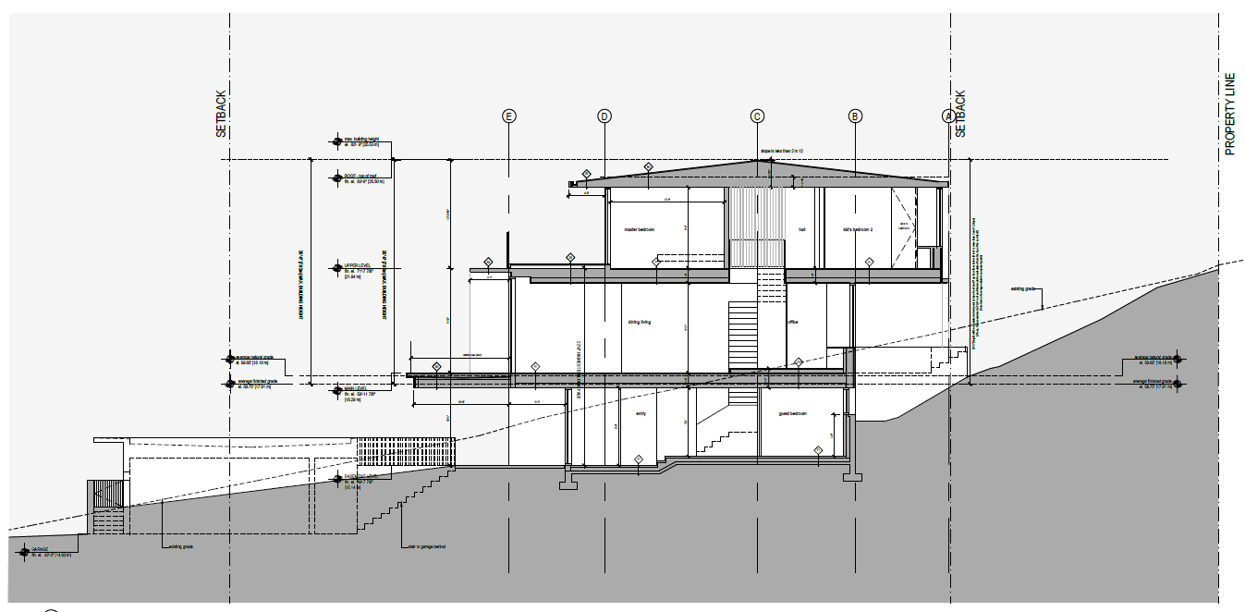
Large Overhangs for Preventing Thermal Gain in Summer & Getting it in Winter
Summer
Winter
The architect designed the house to have large (4 foot) overhangs that will block the sun in the summer time when the sun is high in the sky so we need less cooling but allows the sun to heat the house in the winter when it is lower

Slide 19
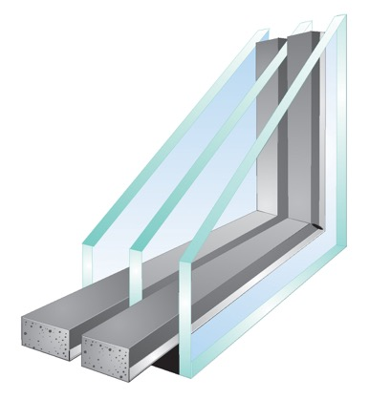
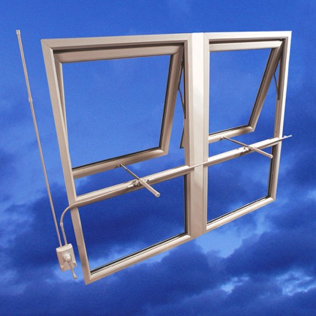
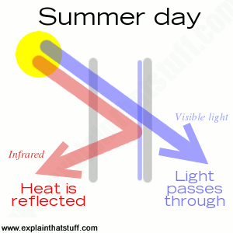
High Efficiency Automated Windows
Glass Coating to block infrared light in summer
Triple Pane Glass
Automated Windows Allowing Free Cooling & Ventilation
All the windows will have triple pane glass to be better insulated and will have special coating to block the infrared light in the summer so we need less cooling. We are thinking of automating the windows so they open on their own to give fresh air on days when it is not too cold or warm.

Slide 20
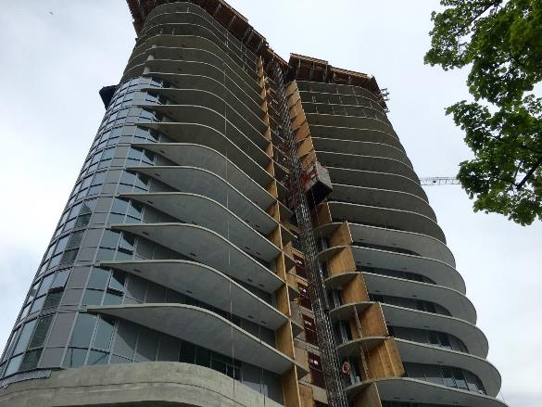
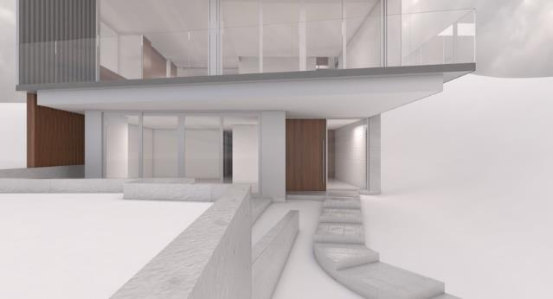
Thermal Bridges
We want to have some decks on our house but the problem is they will conduct unwanted cold in to the house through the floors. This is called thermal bridging. You can see our deck is cantilevered which looks nice but could be a thermal bridge.

Slide 21
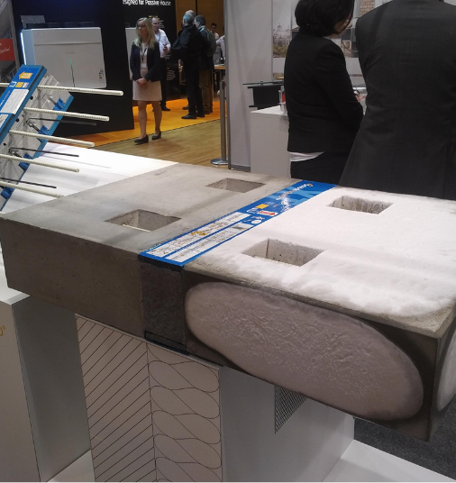
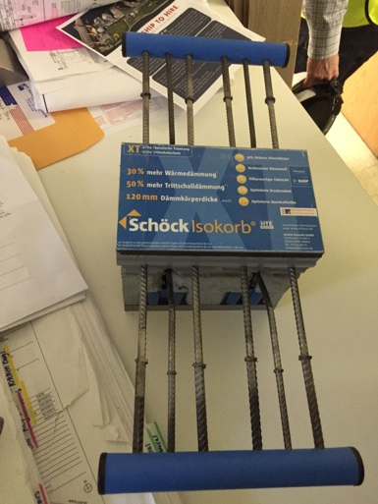
No Thermal Bridges
To solve this problem we use thermal breaks between the concrete floor inside and outside. It has insulation between the concrete but still has steel reinforcing bars to give the concrete the strength between the inside and outside concrete.

Slide 22
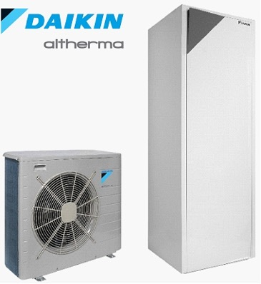
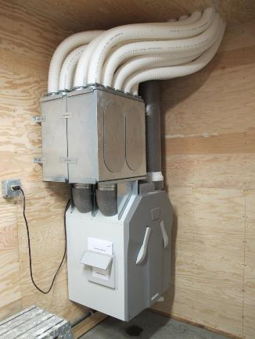
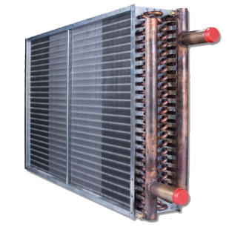
Comfortable and Efficient Heating and Cooling
Using hot and cold water through pipes and a radiant coil to heat or cool the ventilation air
Air to Water Heat Pump for Hydronic Heating, Cooling and Hot Water
Because the house is so well insulated we need very little heating and cooling but will have a small heat pump to heat or cool the ventilation air. Because we have a lot of glass on the south of the house we will need more cooling than heating.

Slide 23
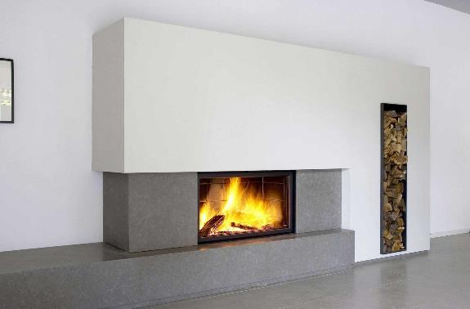
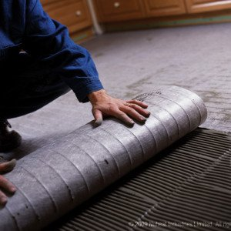
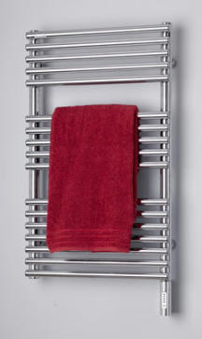
Comfortable Heating
High efficiency wood stove in living room
Electric floor mats and towel radiators in bathrooms for heating
We will have some additional heat for comfort in the living room with an efficient wood burning stove an in the bathrooms will have electric heaters in the floor and towel radiators

Slide 24
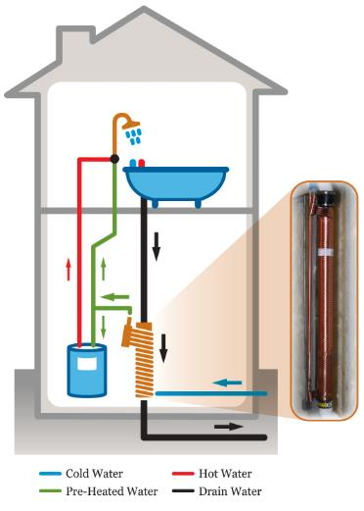
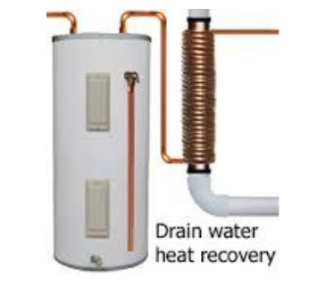
Energy recovery from drain water
We will reduce the energy for heating water for showers and baths by recovering the heat with these copper tubes that go around the drain pipes

Slide 25
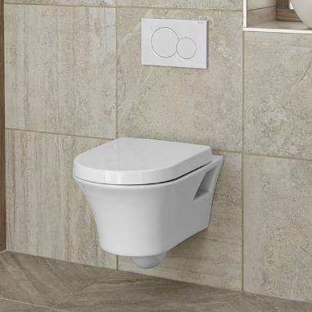
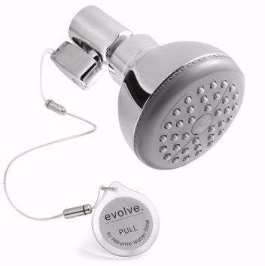
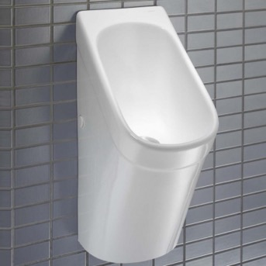
Water Conservation
Water efficient shower and faucets
Dual flush toilets
Water free Urinals
We will try and reduce the amount of water we use with water efficient faucets, dual flush toilets and water free urinals

Slide 26
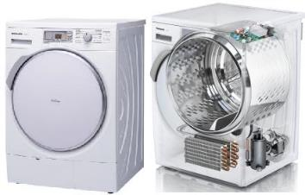
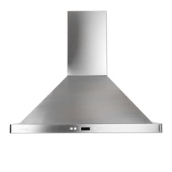
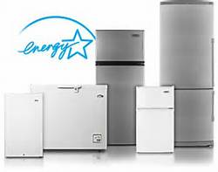
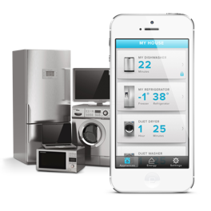
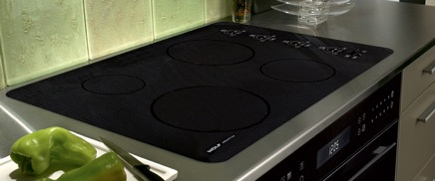
High Efficiency Appliances
Recirculating Range Hood
Heat Pump Condensing Dryer
Energy Star Rated
Internet Enabled Appliances
Induction Cooktops
Our appliances will be energy efficient. The goal is for them to be internet enabled so we can control them from our phone or Google Home and they can be serviced remotely. Because the house is so air tight we will use a recirculating range hood

Slide 27

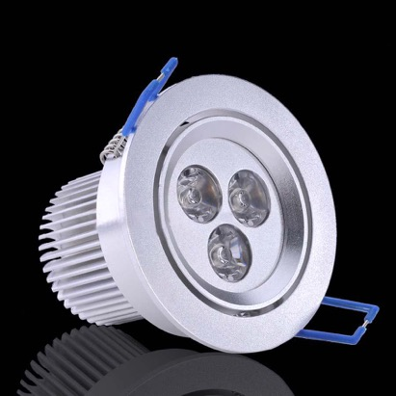

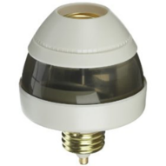
Energy Efficient Lighting and Plug Loads
Whole House Off Switch
Smart Plug Outlets and Switches
LED Lighting
Motion Sensor Lights
Our lights will all be LED and we can turn them on or off from an APP or a whole house off switch or using motion sensors. We will be able to monitor the energy consumption of all the appliances, plugs and lights through an App.

Slide 28

Home Automation and Performance Monitoring
Most of the appliances we are using for lighting, security, tv’s, music, HVAC will all be internet enabled so we can control them from our phones or an iPad

Slide 29



Net Zero Energy with Solar Panels and Battery Storage
Solar power connected to the electrical grid
Battery Storage
Create more electricity than we use
We will have 32 solar panel on the roof producing 10,800 kWh per year. We will also have battery storage which will also can be used as back-up power. And our goal is to sell more electricity back to BC Hydro than we use over the year

Slide 30



Low VOC, from Recycled Materials and Locally Sourced (where possible)
We are selecting paints that are low in chemicals called Volatile Organic Compounds (VOC’s) and we are trying to buy as many materials locally which has been challenging with some of the products needed for Passive House only available in Europe today

Slide 31


Reuse and Recycle with Green Demolition
When we took down our old house we worked with Habitat for Humanity who recycled many of the building materials and resold them in their Restore

Slide 32

With all of the things we are designing into our house we will use very little energy. A Passive House consultant will model this to make sure we meet the standard and give us our Passive House certification. We will also be collecting the data once the house is built to see if the actual energy use matches the model

Slide 33


We had to present our plans for the Passive House to the City of West Vancouver Mayor and Councillors who were very supportive. They thanked us for being the first in West Van to build a Passive House and setting the path for others

Slide 34

This is our old house which wasn’t very energy efficient.

Slide 35

This will be our new house which will be beautiful, comfortable, healthy and energy efficient

Slide 36



Here are some other Passive Houses that show they can be beautiful and also be made into apartments. The picture above is the student residence at Cornell University in New York City. The picture in the top left is a house near Portland and the one in the bottom left is in Whistler

Slide 37

Thank You for your Attention
Any Questions?

